Slide 1

SOIL MOISTURE SYSTEM USING RASPBERRY PI 4
Adeesh Shetty
Adesh Jain
Diya Patel

Slide 2
What is raspberry Pi?
Raspberry Pi is a series of small single board computers developed in the United Kingdom by the Raspberry Foundation. The Raspberry Pi project originally leaned towards the promotion of teaching basic Computer Science in schools and in developing countries. The original model became more popular than anticipated selling outside its target market for uses such as robotics. It is widely used in many areas, such as for weather monitoring because of its low cost, modularity, and open design. It is typically used by computer and electronic hobbyists, due to its adoption of the HDMI and USB standards.

Slide 3
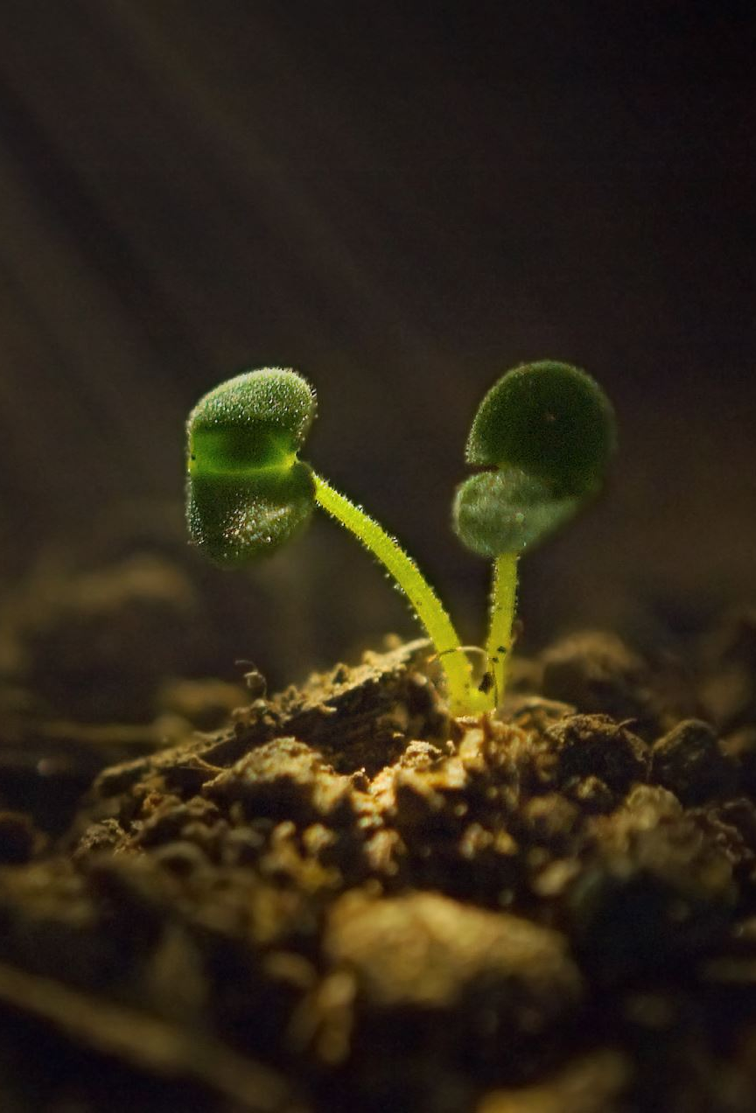
Overview On Soil moisture system:
Nowadays everything becomes autonomous, thus, to check the soil moisture for plants in fields or home plants, This Raspberry Pi project helps you to interface Soil moisture sensor with the Raspberry Pi using MCP3008. When the system begins to run the program, it will check for soil moisture using moisture sensor, if it has any moisture in the soil, the output will show as ‘I’m Sufficient’ and when there isn’t any water shown, then it will be ‘I am Dehydrated’.

Slide 4
COMPONENTS ADDED
The parts needed are:
RPI 4
4 Amp Power Adapter
8GB micro-SD
Jumper Wires
Soil Moisture Sensor
LED Light

Slide 5
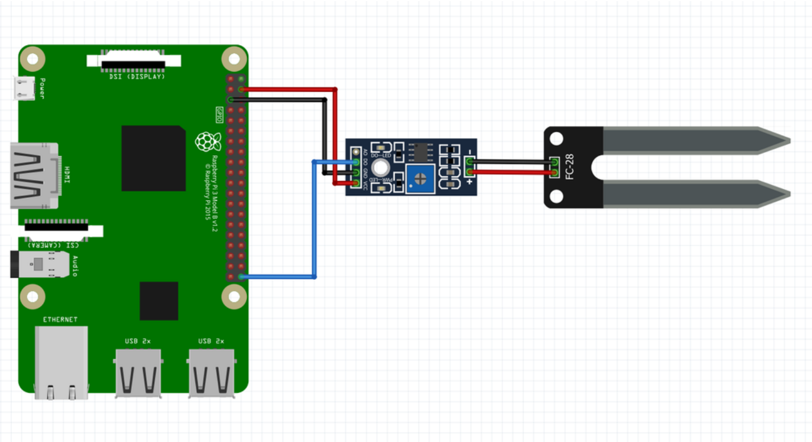
Raspberry Pi Layout

Slide 6
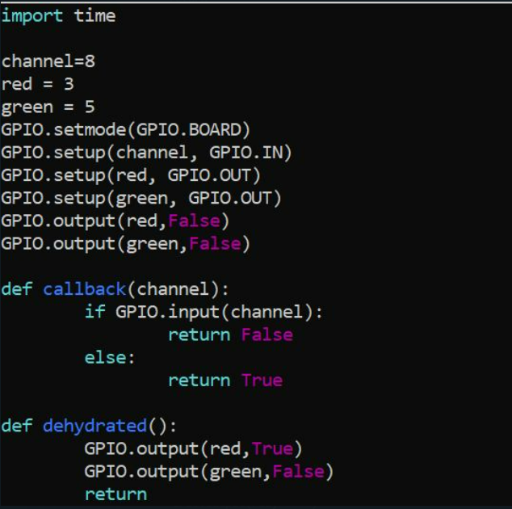
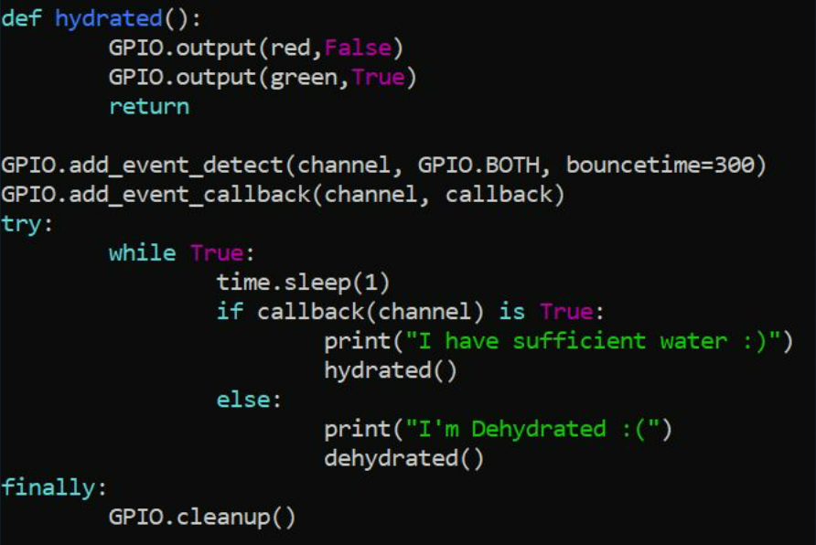
CODE

Slide 7
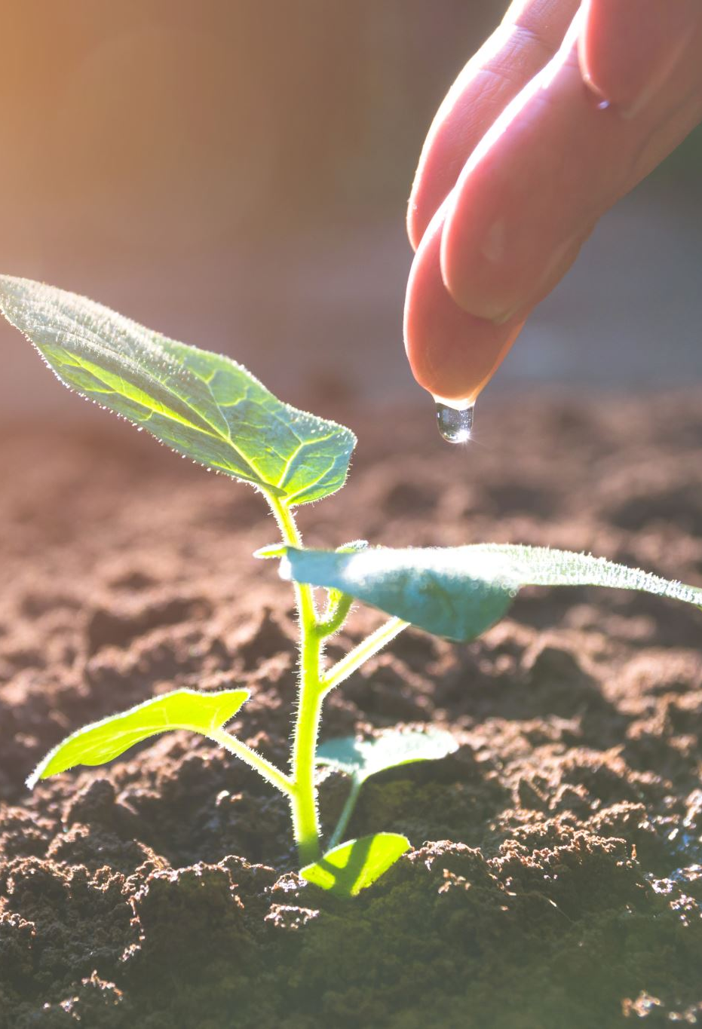
WHY IS SOIL MONITORING IMPORTANT?
Soil moisture sensors aid good irrigation management. Good irrigation management gives better crops, uses fewer inputs, and increases profitability. Soil moisture sensors help irrigators to understand what is happening in the root zone of a crop.

Slide 8
THANK YOU!

